Slide 1
Top Executive role & development
Limassol – October 16th 2012
Jack Hamande
Director General – Federal Public Service Staff & Organization

Slide 2
329 Mio #
Notes:
Google : great place to work

Slide 4
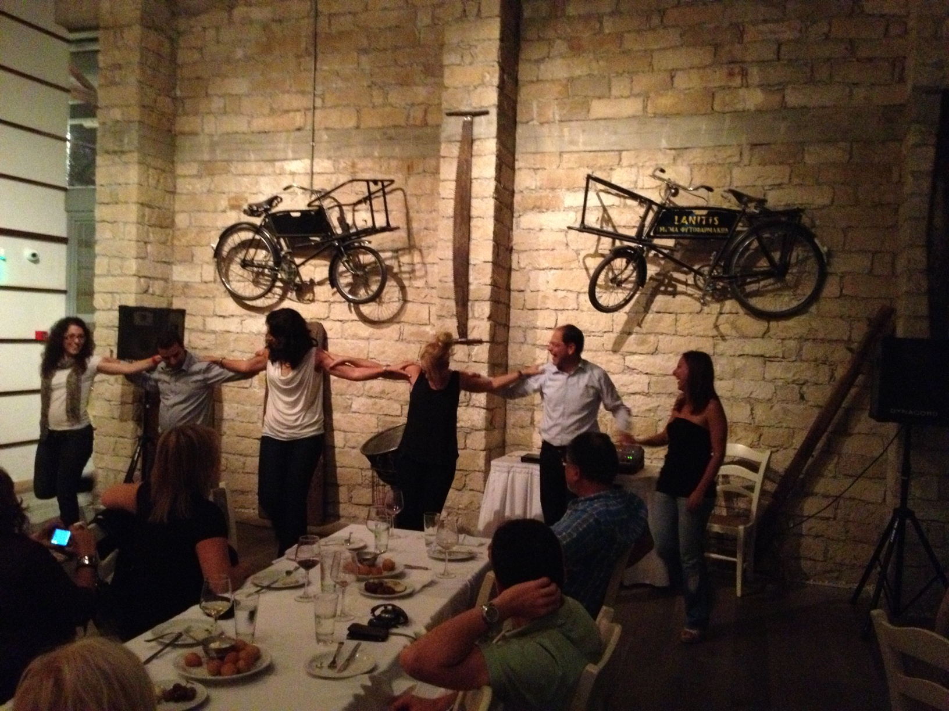

Slide 5
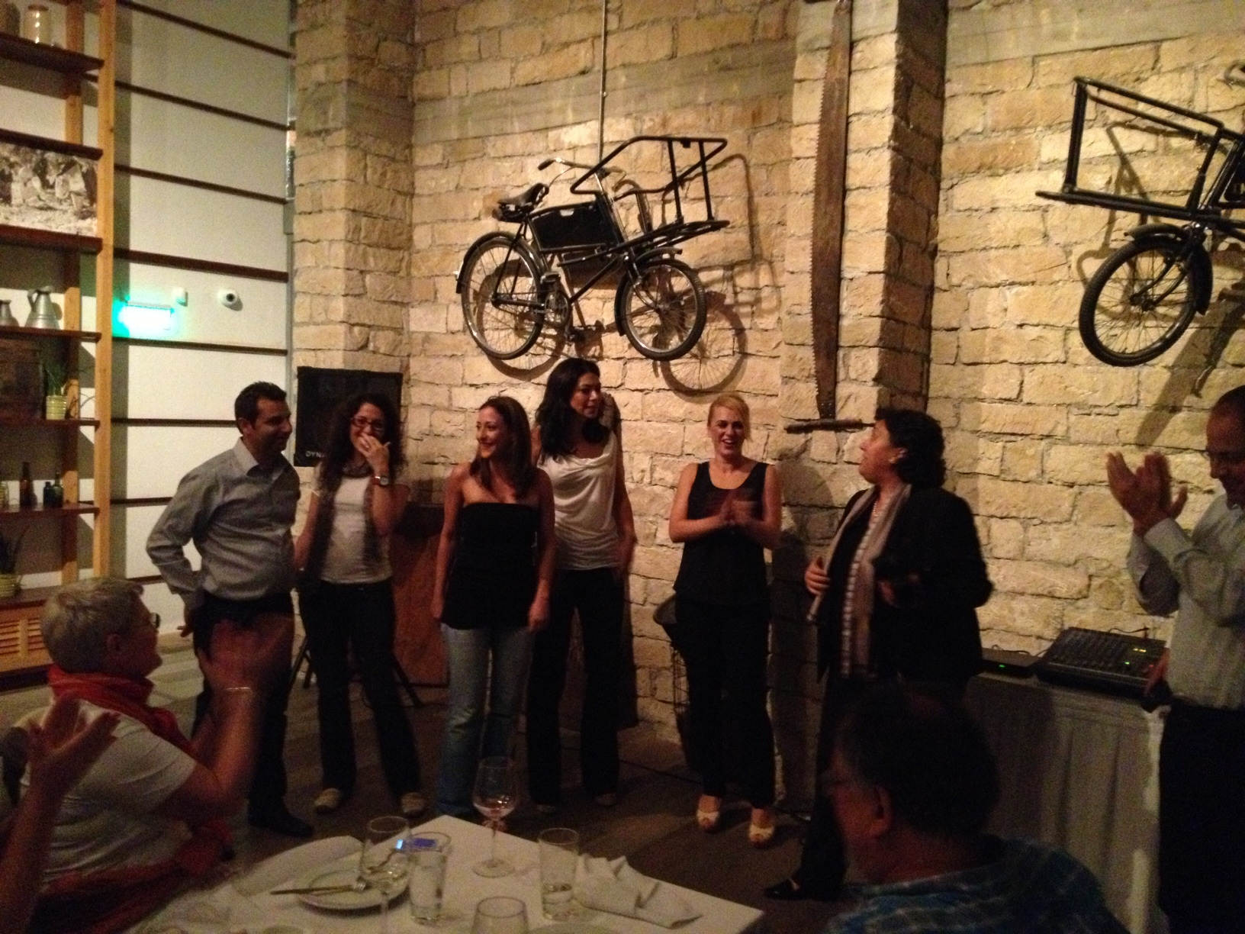

Slide 6
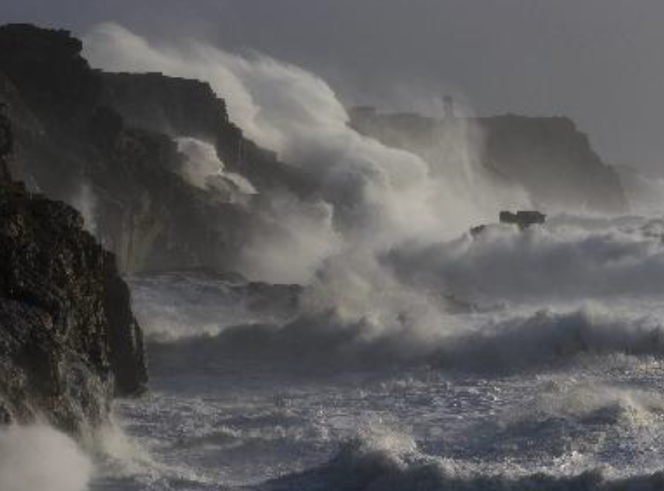

Slide 7
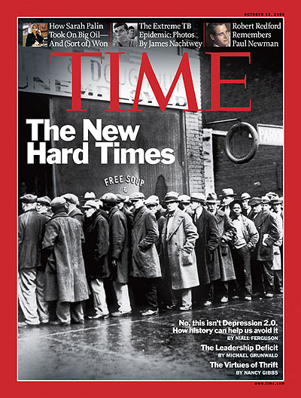

Slide 8
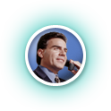
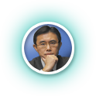
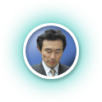
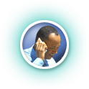
Change in the way we work, where we work, how we work and even the nature of the work itself

Slide 9
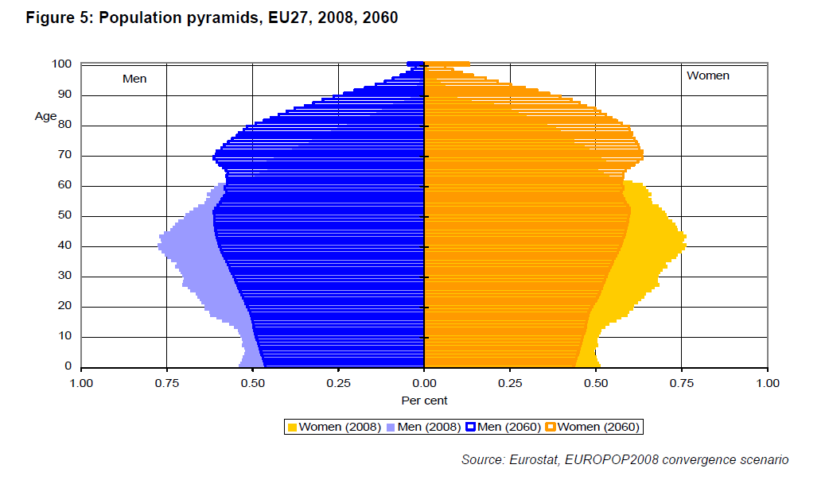
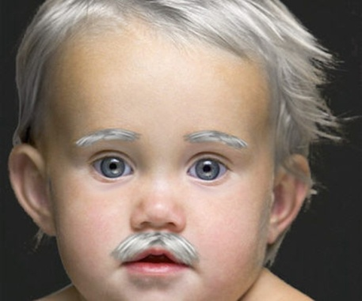
Ageing – Staff & Citizens

Slide 10
Generation Y

Slide 11
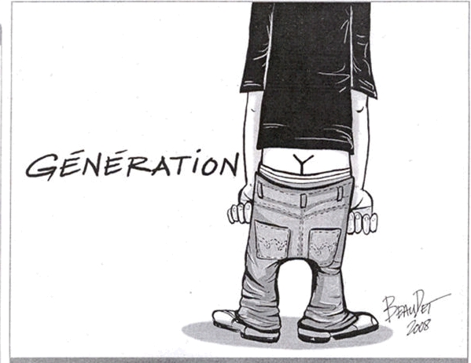

Slide 12
PRIVATE
VS
PUBLIC

Slide 16
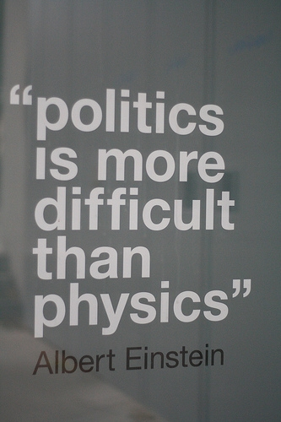

Slide 17
Define Vision, Strategy & Values
Inspire, motivate, develop, empower
Establish and carry out departmental or organizational goals, policies, and procedures
Direct and oversee an organization’s financial and budgetary activities
Manage general activities related to services
Consult with other executives, staff, and board members about general operations
Negotiate or approve agreements with Politics
Appoint department heads and managers
Analyze financial statements and other performance indicators
Identify places to cut costs and to improve performance, policies, and programs
…….

Slide 18
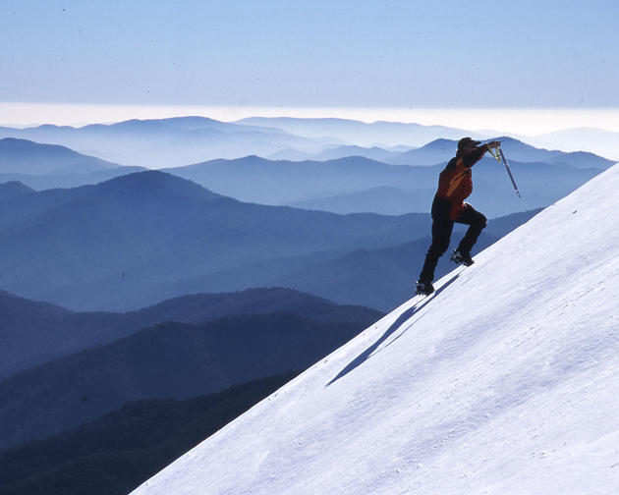

Slide 19
Under Pressure

Slide 20
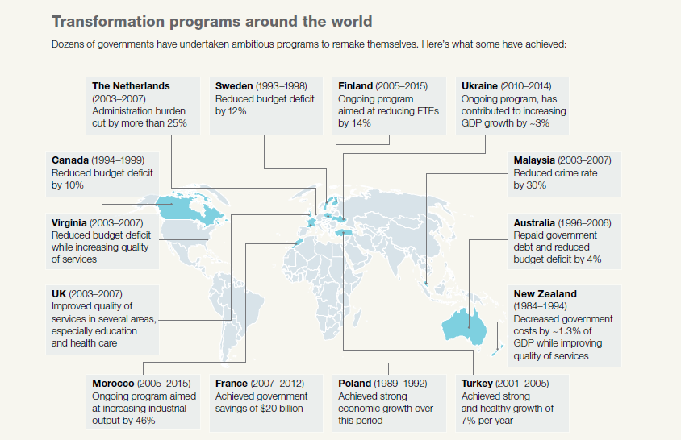
Source: McKinsey – Government designed for new times

Slide 21
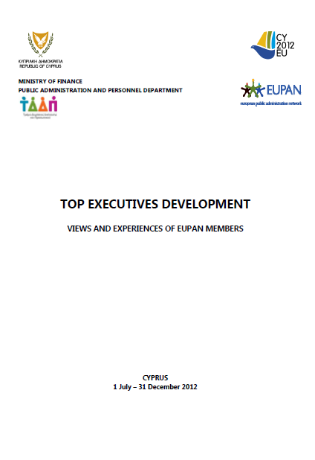
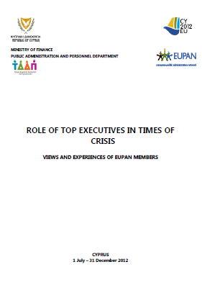

Slide 22
Top Roles
Efficiency Effectiveness
All countries having plans
Actions Requested
Collective Agreements
Salaries / freeze
Recruitment freeze
Rewards management
Managing Budgets
Simplifying processes
Productivity increase
Accountability
Re-organization
E-adminitration
Reform process
Changes management
Cutting expenses
Solve the lack of collaboration - > transversal
Change in working methods
Performance management
Results
But also status & relations with Politics

Slide 23
What can be done ?
Expectations vs Mission
Strategic Planning
Usage of technology as a source of efficiency
Implement monitoring
Motivate people
Placing the citizen as a center of attention
Retaining talents
Decision process transparent
HR Management
Communication
Show leadership
Redefine Mission Statement of the Units

Slide 24
Individuals/Team/DGs
Cascade
Skills (strategic/Mgmt/…)
Short prog/journeys
Handle with context ?

Slide 25
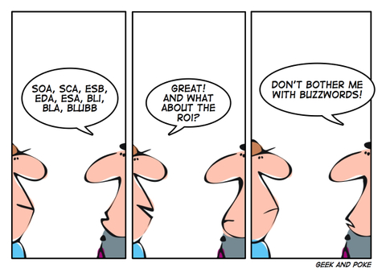

Slide 26
Notes:
Carrière :
1/ L'avancement de carrière, les promotions et autres mouvements de personnel sont basés sur des critères objectifs et transparents
carrière
2/ Je trouve en interne le soutien nécessaire pour me préparer à une fonction future
3/ J'entrevois des opportunités de carrière au sein du SPF XXX
4/ J'ai des entretiens réguliers sur mon fonctionnement qui me permettent d'évoluer
Culture d'organisation
1/ Le SPF XXX est particulièrement à l'écoute de son personnel
2/ Le management du SPF XXX sait où il va, comment il y va, et il inspire ses collaborateurs
3/ La vision et les décisions du management me donnent envie de contribuer aux objectifs de notre organisation
carrière
Communication
1/ Je suis rassuré(e) sur les changements susceptibles de m'affecter (réorganisation, déménagement, méthodes de travail, procédures…)
2/ Je suis informé(e) dans les temps sur mes changements susceptibles de m'affecter

Slide 27
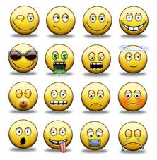
85 %

Slide 30
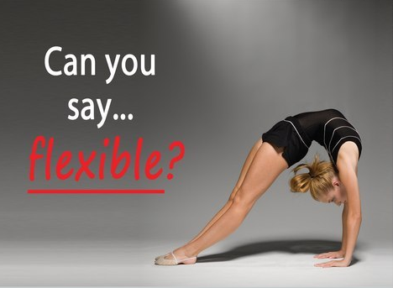

Slide 31
Vision

Slide 32
Communication

Slide 34
Leaders

Slide 36
« You must be the change you want to see in the world »
Mahatma Gandhi

Slide 37
“..Vision with action can change the world!”
Joel Arthur Barker

Slide 40
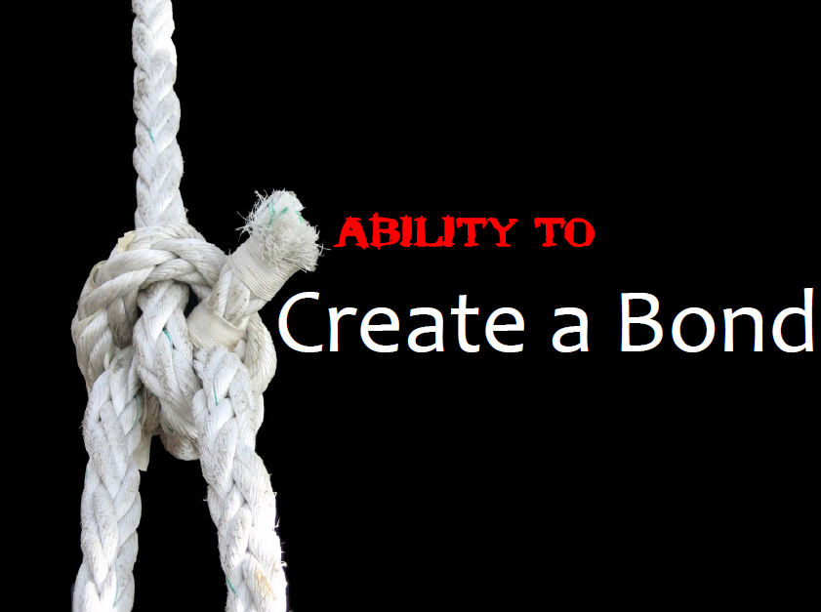

Slide 44
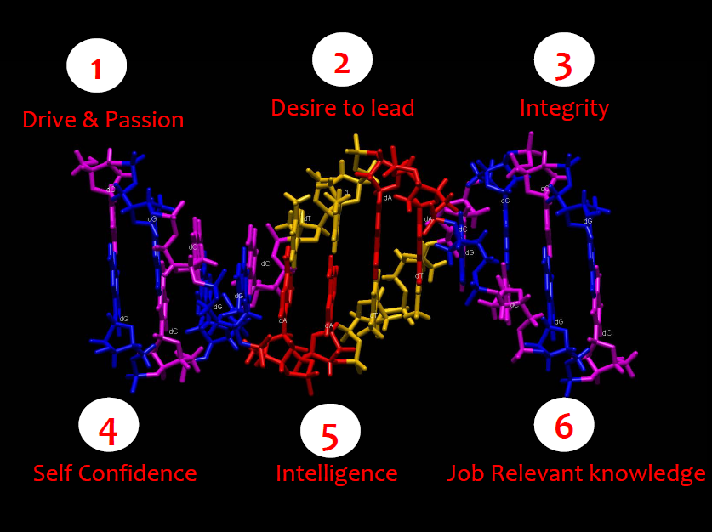

Slide 45
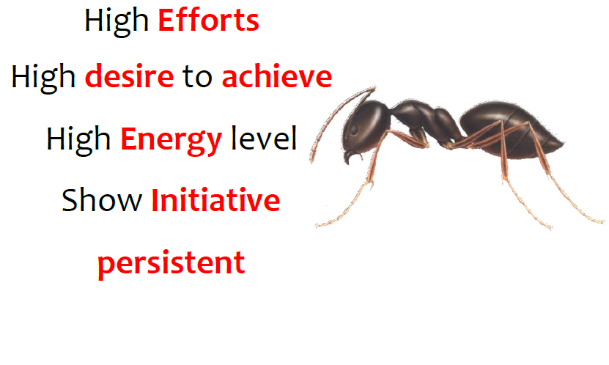

Slide 47
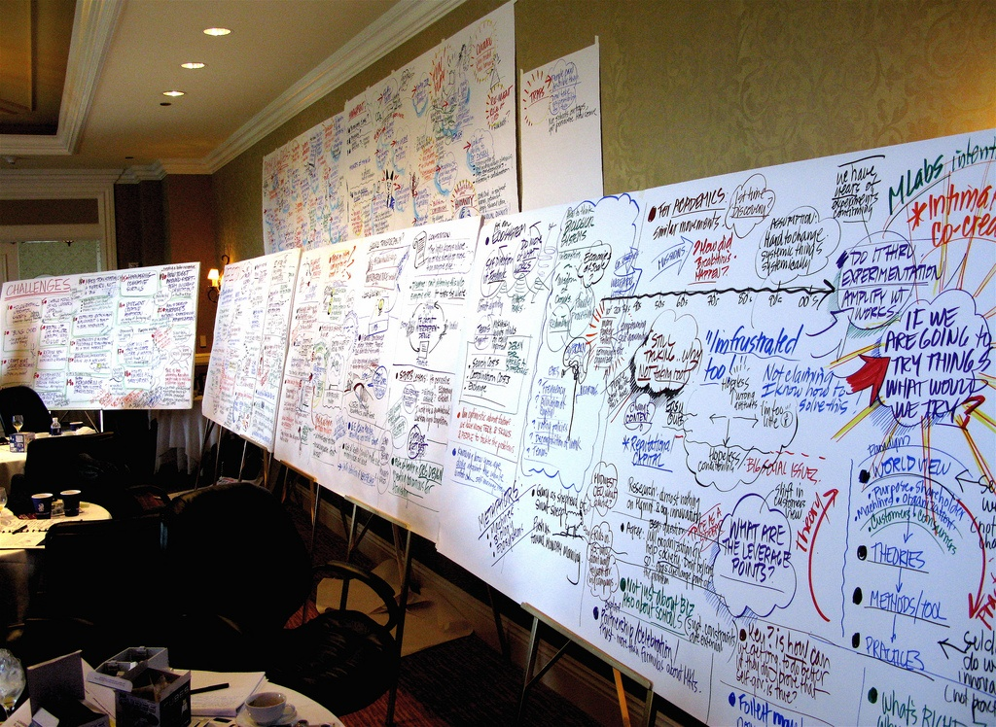
Leader Makes Decision

Slide 48
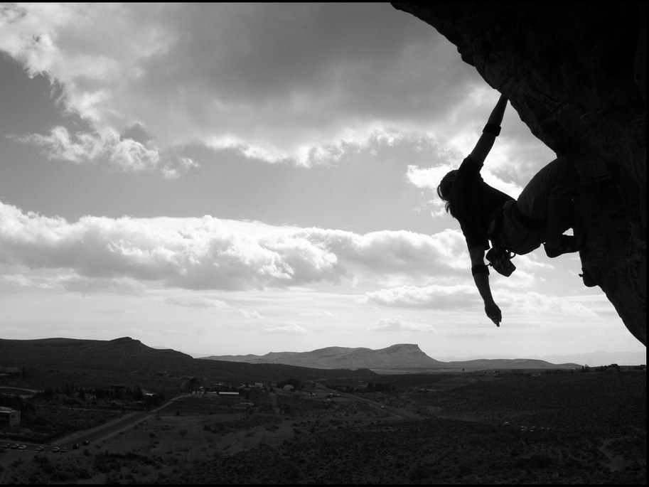
Leader takes Risks

Slide 49
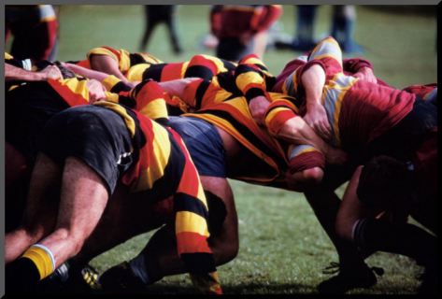
TEAM TEAM TEAM

Slide 51
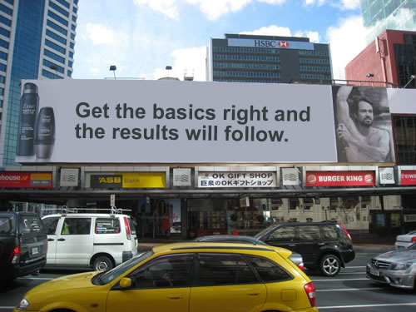

Slide 53
Contract with Politics & cascading

Slide 54
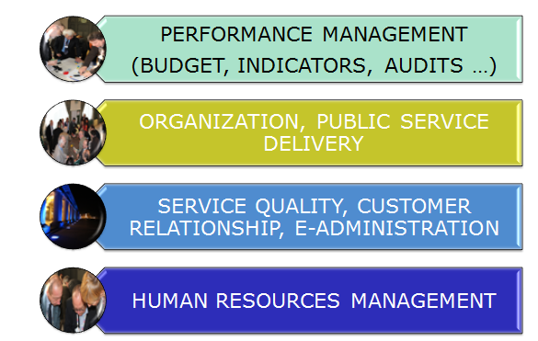
Priorities

Slide 55
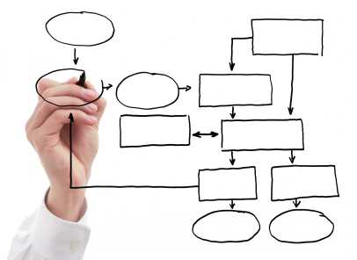
3 pillars
External Costs
Operations
Transformations

Slide 56
Possible
Together
With Less
Otherwise

Slide 57
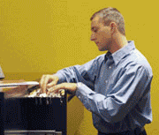
Culture…
Creating an environment where people can speak up, can participate, can have successful careers
Talent Development
Reflecting customers, partners, communities
Welcoming different approaches, styles, perspectives, experiences,
initiatives

Slide 58
Human Oriented Leadership journey
Linking Individuals, Teams, Organizations

Slide 59
4 years….
286 participants,
40 organizations
Transversal
59

Slide 60
Strategic
Individuals
Technical
Development 3x3
Strategic
Tactical
Operational

Slide 61
Individual
Organization
Networking

Slide 62
Individual
Module | Top managers & executives | Middle managers | P&O staff
Intake
Vitruvius Journey
Individual Coaching
Peercoaching
Intervisions
Mindfulness leadership
Intake d’orientation
Trajet Vitruvius
Nouveaux Services
Coaching individuel pour Top

Slide 63
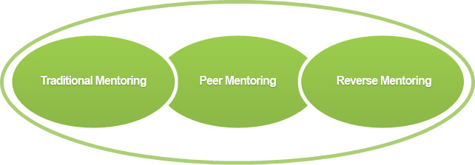
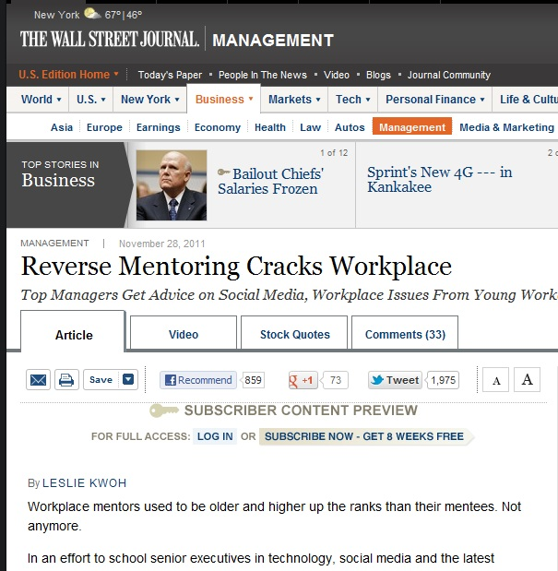
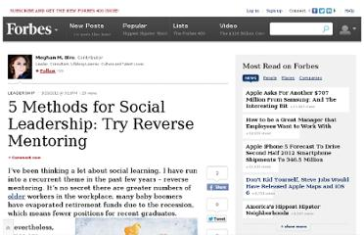

Slide 64
Organization
Module | Top managers & executives | Middle managers | P&O staff
Intake
Team coaching
Leadership culture
Train the trainer inductive learning

Slide 65
Networking
Alumnis
Refresh
Leadership awareness
Viral projects

Slide 69
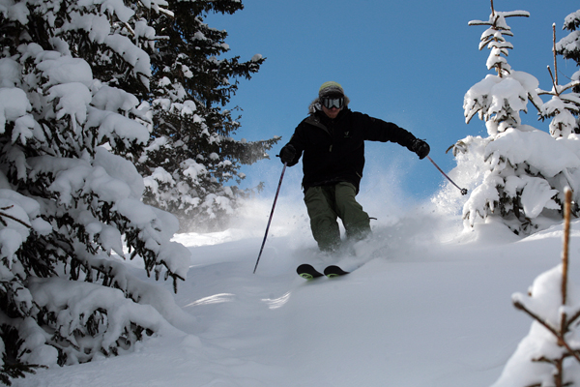

Slide 70
Wrap Up
Back to basics : Do the things Right ! Do the Right Things !
Crisis - > alternatives/solutions, out of the box, People, culture & empowerment
Anticipations vs Reactions
High expectations from the TOP & development - > what’s about you ?
Leadership definitions ?
Trainings vs Journey
One stop show vs multilayers !

Slide 72
Leadership program powered by EUPAN/DISPA ?
Co-peering ?
Co-development ?
Co-management ?
Co….. ?
Middle Management ?

